Slide 1
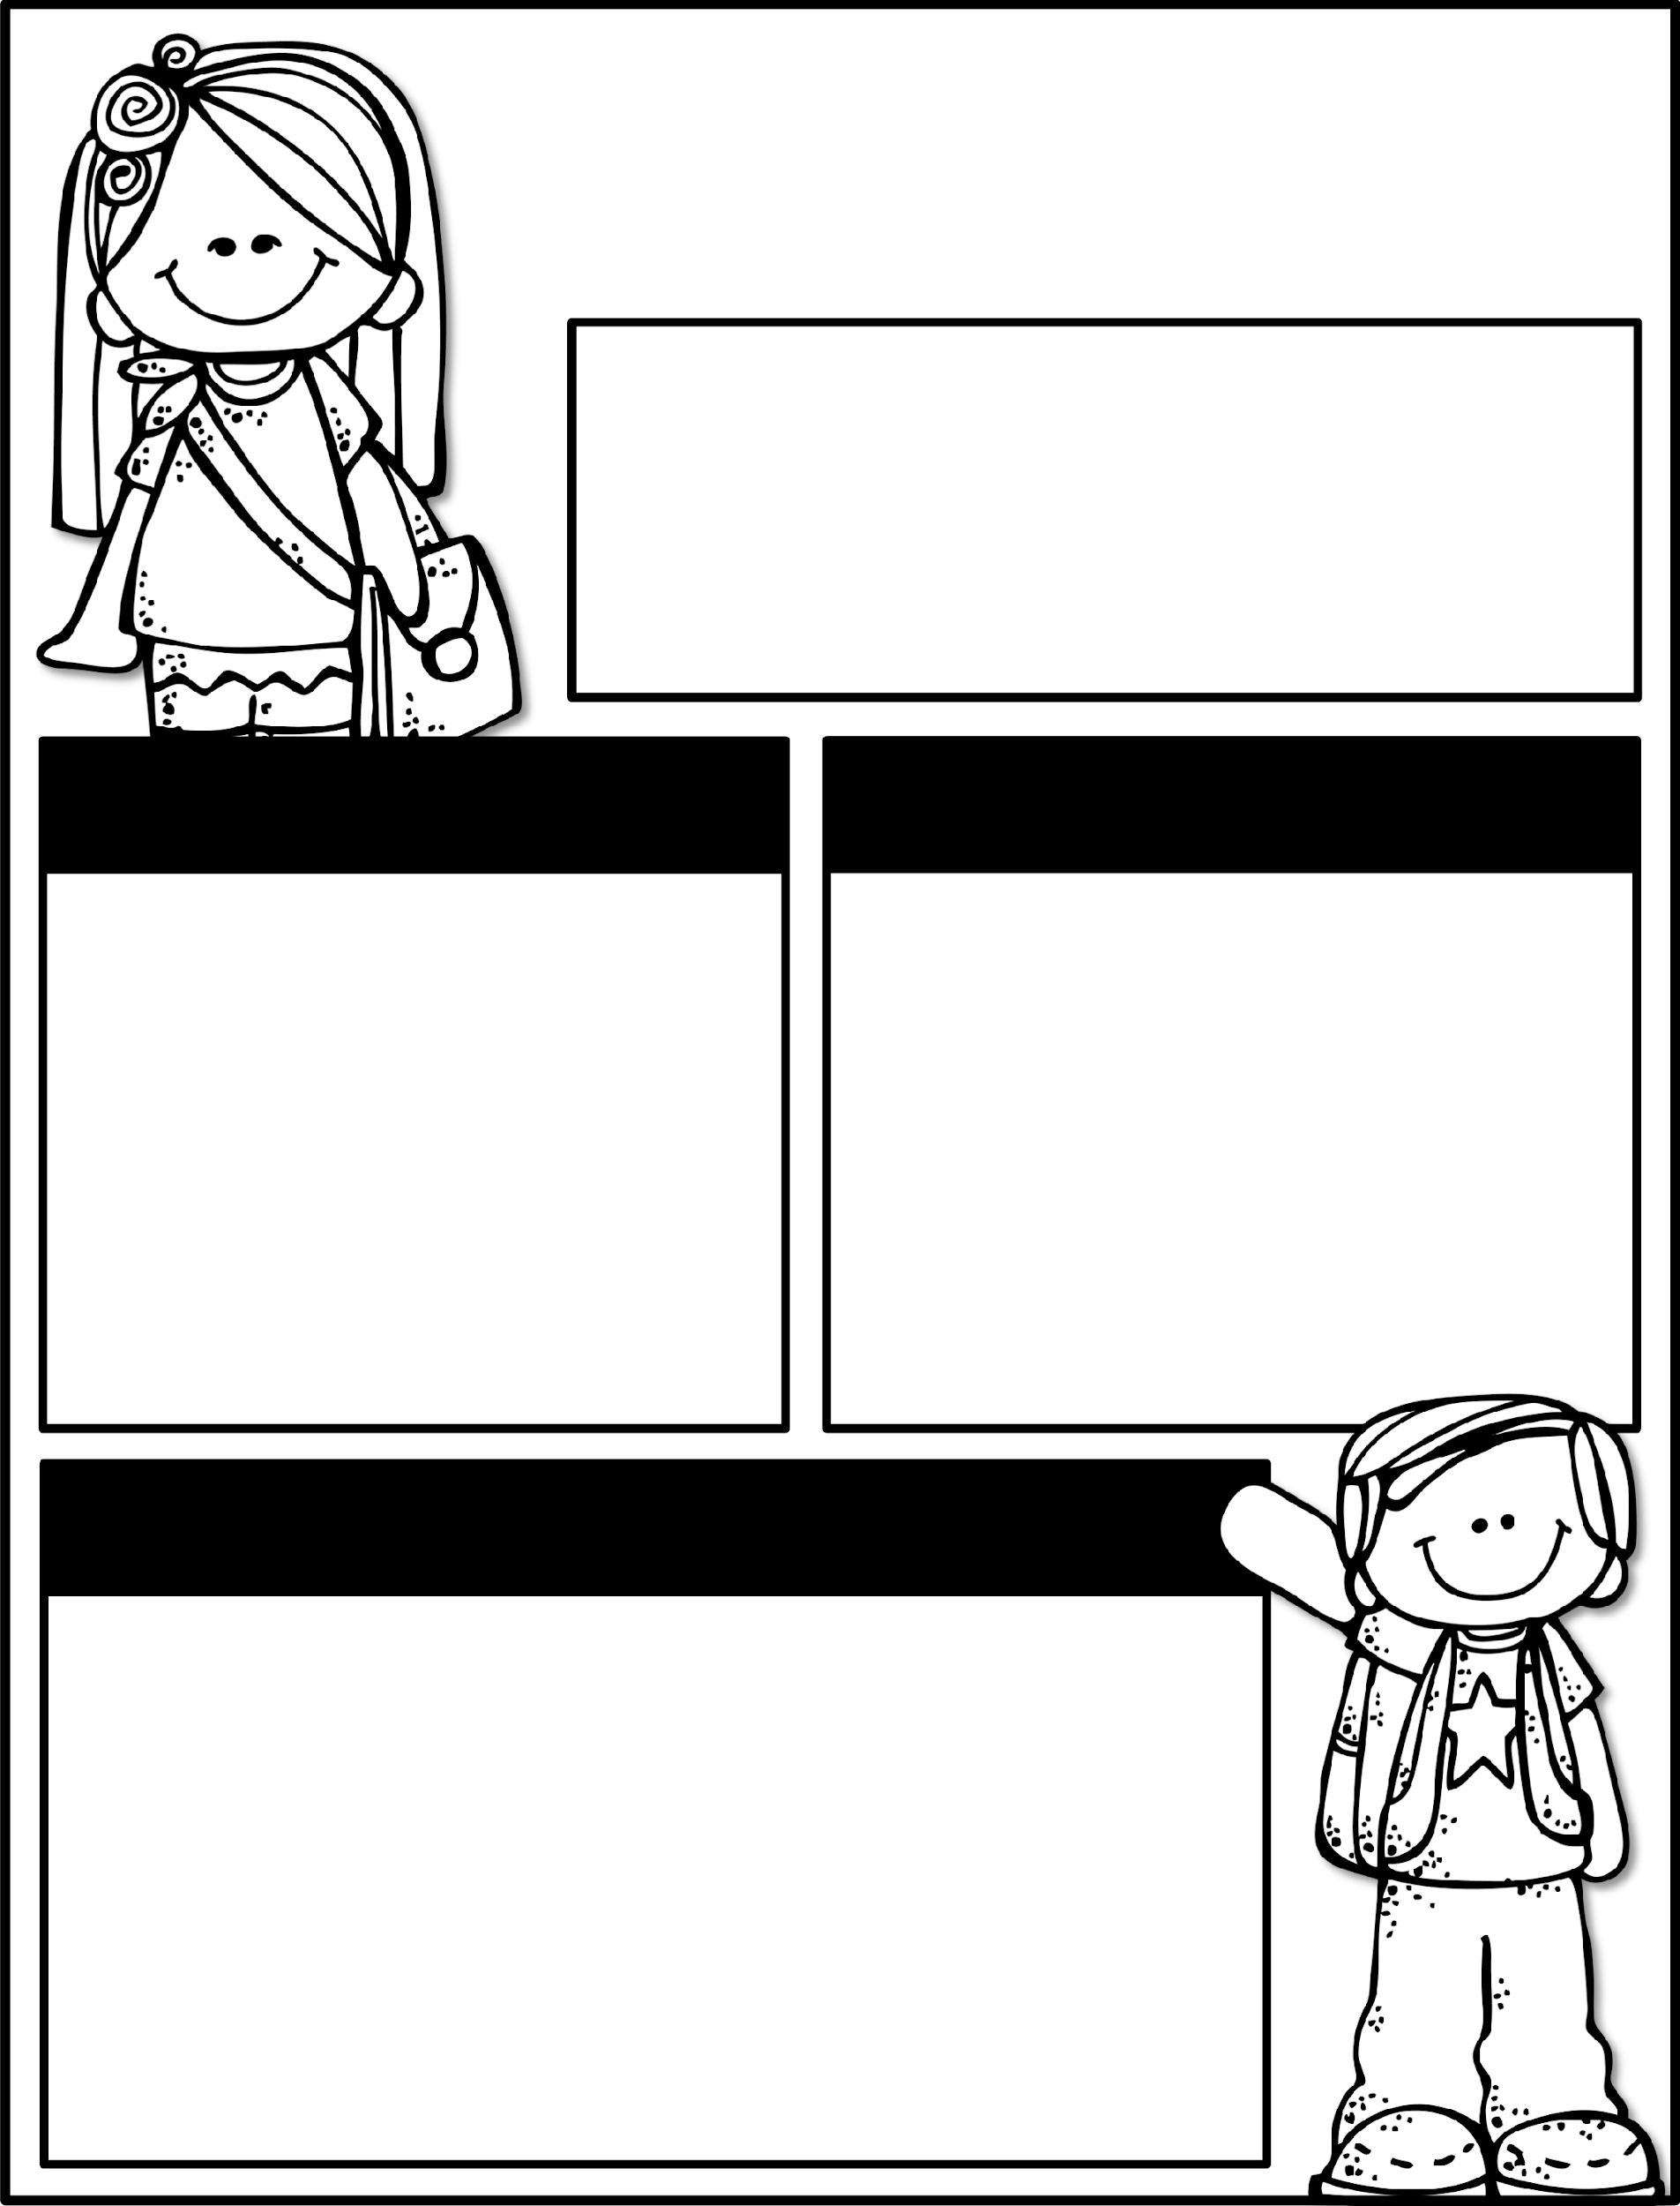

Kindergarten News
September 23-27, 2024
Class News
Learning Focus
Welcome Back! I hope you had a safe and relaxing Fall Break. The timeline project is due Thursday, September 26. Please let your student show you how capable he/she is to write and create on this project. Friday, September 27, is the Fall Festival. Remember to return the PTO form if you want to order armbands or volunteer to help PTO. You can still send in candy for the Fall Festival and “Feed the Monster”!
October 11th is an Early Release Day. School will be dismissed at 11:15am. This will also be our fall conference date. Sign ups will come out soon.
Upcoming Events
Learning Focus
9/26 - Timeline project due
9/27 - Clubs
9/27 - Fall Festival 6pm
10/11 - Early Release - dismissal at 11:15am
Birthdays
Brody 9/3
Ender 9/3
Mrs. Otis 9/14
Reading: Asking and answering questions about key details, characters, and setting
Writing: Narrative text
Math: Classify objects by their attributes
Phonics: Letters / Letter sounds
Social Studies: Day/Week/Month and Past/Present/Future
Sight Words to practice
a, the, as, to, do, I, is, am, at, an, man, in, it
Contact Me:
Email: olivia.otis@henry.k12.ga.us
School Phone Number: 770-898-7362
Reminders
Please check your child’s binder each night. Check Dojo each night.
Ask questions if you have them!
Please send a water bottle and daily snack for your child.
Please keep a change of clothing in your child’s bookbag .
We have completed the GKIDS assessments. This measures what your child knows entering kindergarten. Your child’s report will be his/her first report 9-week report card.

